Slide 1
FACTORS AFFECTING ENTREPRENEURIAL GROWTH

Slide 2
1.Economic Factors
Capital
Labour
Raw materials
Market

Slide 3
Capital
Capital is lubricant to the process of production.
When capital supply increases, entrepreneurship also increases.

Slide 4
Labour
Availability of labour makes entrepreneurship attractive.
Presence of skilled labour force is required for uninterrupted production.

Slide 5
Raw materials
Raw materials are required for establishing any industrial activity and it influences entrepreneurship.
Availability of raw materials is based on opportunistic conditions and these have to be favourable.

Slide 6
Market
Market fetches revenue for any business.
It is equally important to ensure futuristic opportunities.

Slide 7
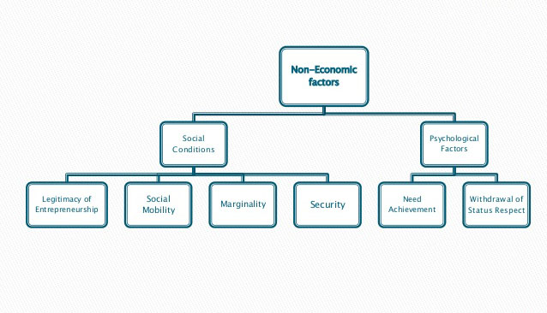
2.Non Economic factors

Slide 8
Social conditions
Legitimacy of entrepreneurship :
  More authority to entrepreneurs with change in tradition, social and cultural values is needed
Social Mobility :
  High degree of mobility is conducive to entrepreneurship
Marginality :
  A group of people from a given social system must assume entrepreneurial roles
Security :
  Security is an important facilitator of entrepreneurial behaviour.

Slide 9
Psychological factors
Need achievement :
  A high level of need achievement is a determinant of entrepreneurship.
Withdrawal of status respect :
  There must be a respect for the status of a society to motivate entrepreneurial growth.
    Retreatist : Continues to work
    Ritualist : Defensive behaviour
    Reformist : Forms a rebellion
    Innovator : Creative and likes to be an entrepreneur

Slide 10
3. Government actions
Government actions or failure to act influence both economic and non-economic factors entrepreneurship.

Slide 11
ENTREPRENEURSHIP DEVELOPMENT PROGRAMME

Slide 12
Entrepreneurship Development Programme
EDP is a programme meant to develop entrepreneurial abilities among the people.
It refers to inculcation, development and polishing of entrepreneurial skills into a person needed to establish and successfully run his/her enterprise.

Slide 13
Need for EDP
Creation of employment opportunities
Capital formation
Balanced regional development
Use of local resources
Improvement in per capita income

Slide 14
Importance of EDP
Increases abilities of entrepreneurs
Improves performance to the maximum
Helps in adopting new techniques
Helps in achieving standardization
Reduces fatigue

Slide 15
Objectives of EDP
Develop and strengthen entrepreneurial quality.
Analyze environmental setup.
Formulate project.
Understand the procedure involved in setting up a small scale industry.
Know the pros and cons in becoming an entrepreneur.
Emphasize on entrepreneurialdiscpline.

Slide 16
Other objectives of EDP
Lets entrepreneurs to reset their objectives and strive for realization.
Preparing entrepreneurs to accept uncertainties in running a business.
Enable decision making.
Enable effective communication.
Develop a broad vision about business.
Develop passion for integrity and honesty.
Learn compliance with law.
Subscribe industrial democracy.

Slide 17
Course contents - EDP
General introduction to entrepreneurship
Motivation training
Management skills
Support system and procedure
Fundamentals of project feasibility
Plant visits

Slide 18
Course contents - EDP
General introduction to entrepreneurship :
  General knowledge of entrepreneurships
  Role of entrepreneur in economic development
  Entrepreneurial behaviour
Motivation training :
  Induces need for achievement
  Successful entrepreneurs share their experience

Slide 19
Course contents - EDP
Management skills :
  Managerial skills like finance, production and marketing are imparted
Support system and procedure :
  Exposure on support available from different institutions and agencies
  Procedure for approaching is also taught

Slide 20
Course contents - EDP
Fundamentals of project feasibility study :
  Provided guidelines on effective analysis of feasibility or viability of a project
  Feasibility is tested from the viewpoint of marketing, organization, technical, financial and social aspects
Plant visits :
  Helps in knowing about entrepreneur behavior, personality, thoughts and aspirations

Slide 21
Phases of EDPs
Pre training phase
Training phase
Post training phase

Slide 22
Pre-training phase
Activities and preparations required to launch the training programme comes under this phase.
It includes :
  Formation of selection committee for selecting trainees
  Selection of tools, techniques to select entrepreneurs
  Selection of entrepreneurs
  Tie-up of guest faculty for the training purpose
  Arrangement of infrastructure
  Arrangement for inauguration
  Arrangement for publicity
  Development of application form
  Finalization of training syllabus
  Survey of opportunities in given conditions

Slide 23
Training phase
It helps in bringing desirable change in the behavior of trainees.
The following changes are noted by the trainer among the trainees:
  Attitudinally tuned about project idea?
  Whether trainee will plunge into entrepreneurial career and bear risks in it?
  Whether there is any perceptible change in entrepreneurial outlook, skills, role..?
  What traits the trainee lacks?
  Whether trainee possesses knowledge of technology, resources and other aspects related to entrepreneurship?
  Does trainee possess skill in selecting viable project and mobilize resources at right time?
  How should he/she behave like an entrepreneur?

Slide 24
Post-training phase
This phase involves assessment to judge how far the objectives of the programme have been achieved.
This is a follow-up which :
  Reviews pre-training work
  Review process of training programme
  Review past training approach

Slide 25
Evaluation of EDPs
There is a need to have a look at how many participants have actually started their own enterprises after completing the training.
On an average, one out of four trainees start their own enterprise(26%).
About 10% of trainees are found blocked due to various reasons.

Slide 26
Criteria to assess effectiveness of EDPs
Activity level of respondents
New enterprises established
Total investments made
Investment in fixed assets made
No of people employed
No of jobs created
Increase in profit
Increase in sales
Quality of product/service improved
Quicker repayment of loans

Slide 27
Impact of EDP
Impact of EDP is identified by measuring the changes in entrepreneurial behavior on four dimensions :
      Planning orientation
      Achievement orientation
      Expansion orientation
      Management orientation

Slide 28
Problems of EDPs
Trainer motivations are not found upto the mark
ED organizations lack in commitment and sincerity
Non conducive environment
Attitude of supporting agencies
Selection of wrong trainees

